Slide 1
Introduction to
QuarRC
Real-time control of hardware devices

Slide 2
Background
  Set of real-time Matlab and Simulink tools
  Teleoperation/Streaming data
  Data Acquisition

Slide 3

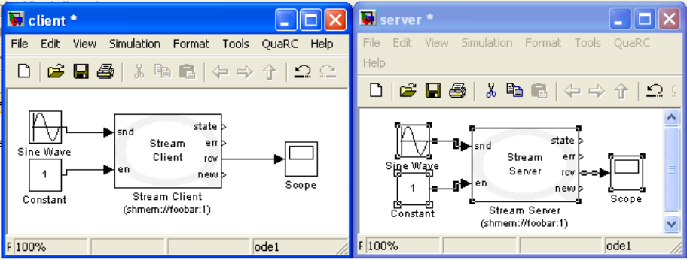





Communication: Basic
Send data
Connection State
Error?
Receive data
Enabled?
Is there new data?

Slide 4


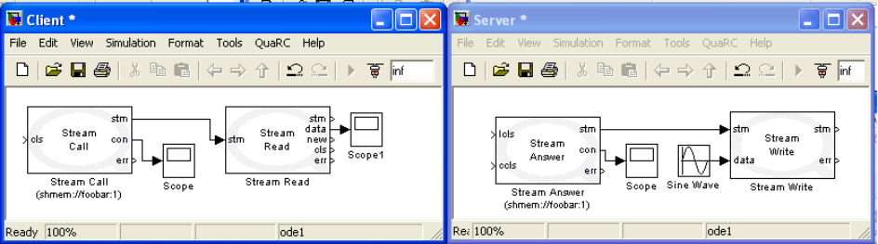

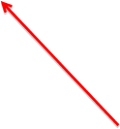

Communication: Intermediate
Data stream
Receive data
Stop Listening?
New data?
Connection Closed?
Close Connection?
Error?

Slide 5
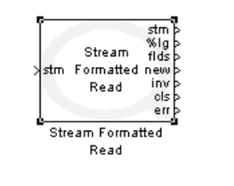
Communication: Intermediate
  Can connect to HyperTerminal
Parsed data
# Fields read
Invalid?

Slide 6
Communication demo
(Intermediate)

Slide 7
Devices
  Game controllers (Wii, generic, mouse/keyboard)
  Robotic Arms
  Haptic controllers (Novint Falcon, Quanser)
  Sensors (accelerometers, force-torque, camera)

Slide 8
Data Acquisition
  Immediate
  Buffered
  Timebase

Slide 9
Features
  Universal Resource Identifier
  Dynamic Reconfiguration
  Multi and Asynchronous threading
  C, .NET, Java APIs

Slide 10
Dynamic Reconfiguration demo

Slide 11
URI demo

Slide 12
Safety
  Watchdog
  Remote Stop
  Error Handling

Slide 13
Other included blocks
  Math (Rotations, discrete state space, …)
  Outputs (FIFO, plots)
  Image Processing

